Slide 1
SPACE X DATA ANALYSIS
JACK MOTZKIN

Slide 2
Intro
We are using a SPACEX data set to explore their data
Data Collection/Data Wrangling
data collection and data wrangling methodology related slides (1 pt)
EDA and interactive visual analytics methodology related slides (3 pts)
Predictive analysis methodology related slides (1 pt)
EDA with visualization results slides (6 pts)
EDA with SQL results slides (10 pts)
Interactive map with Folium results slides (3 pts)
Plotly Dash dashboard results slides (3 pts)
Predictive analysis (classification) results slides (6 pts)
Conclusion slide (1 pts)
Applied your creativity to improve the presentation beyond the template (1 pts)

Slide 3
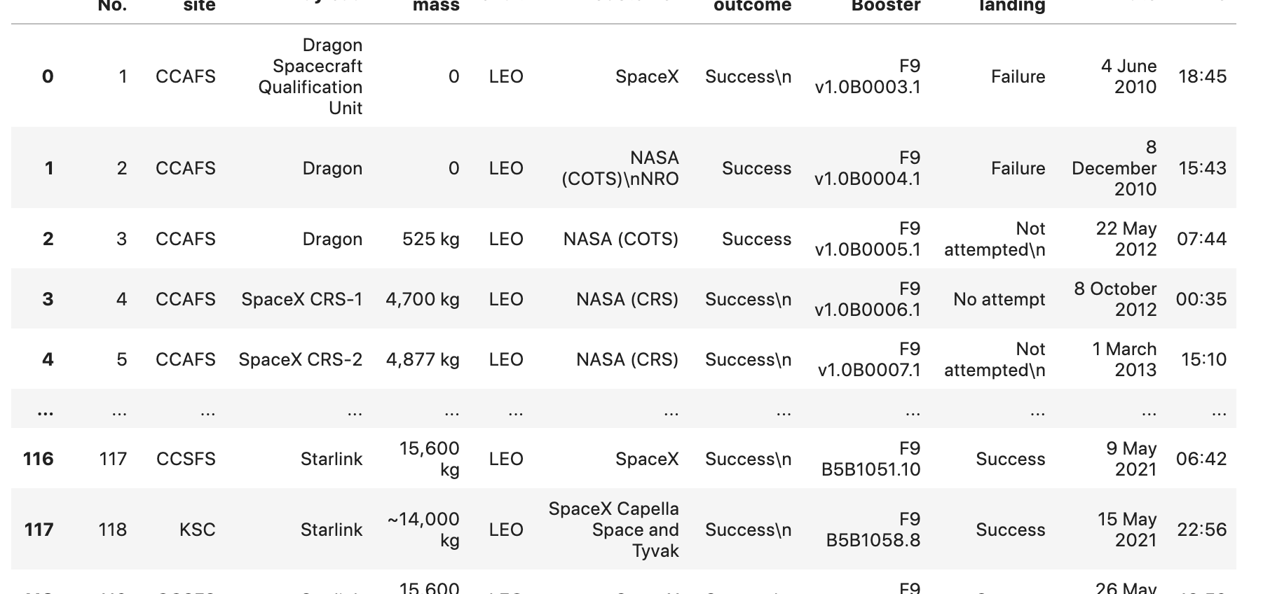
Data Collection/Data Wrangling
Scraped their data
Organized their data into dataframes
Filter and Clean Data

Slide 4
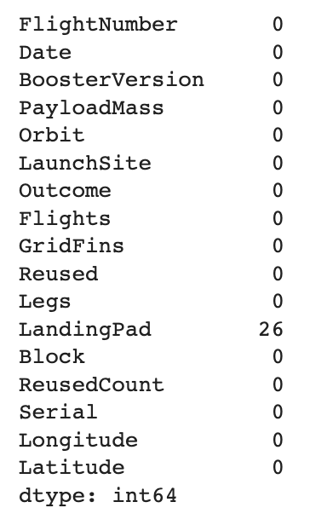
EDA Interactive Visual Analytics
Make an actual dataframe from the organized data

Slide 5
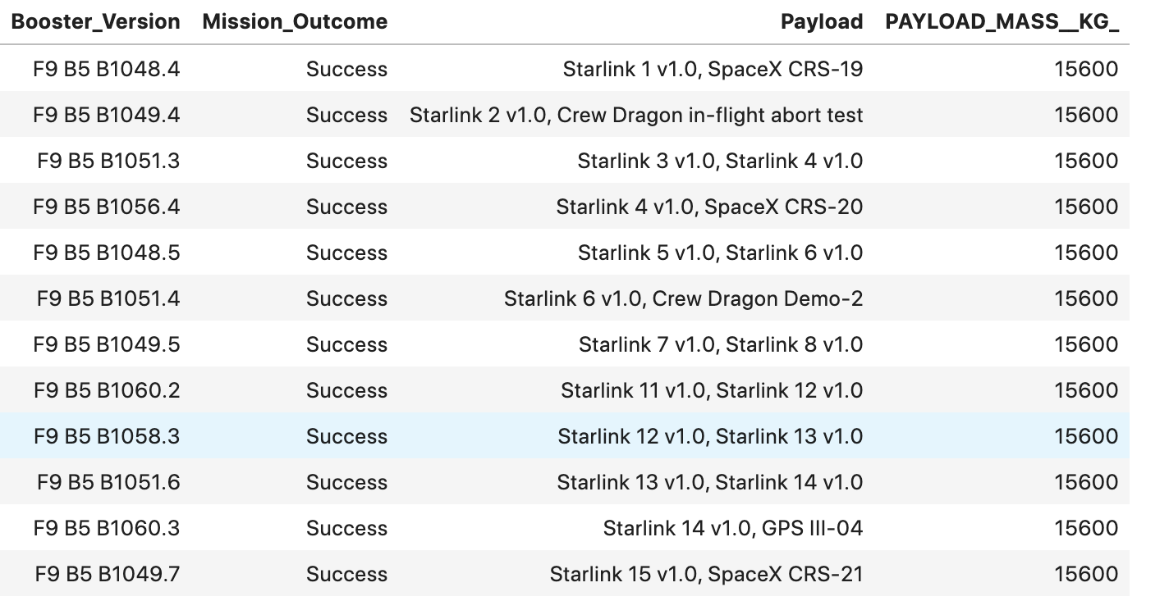
EDA with SQL Results
EDA with SQL
Used SQL to create tables

Slide 6
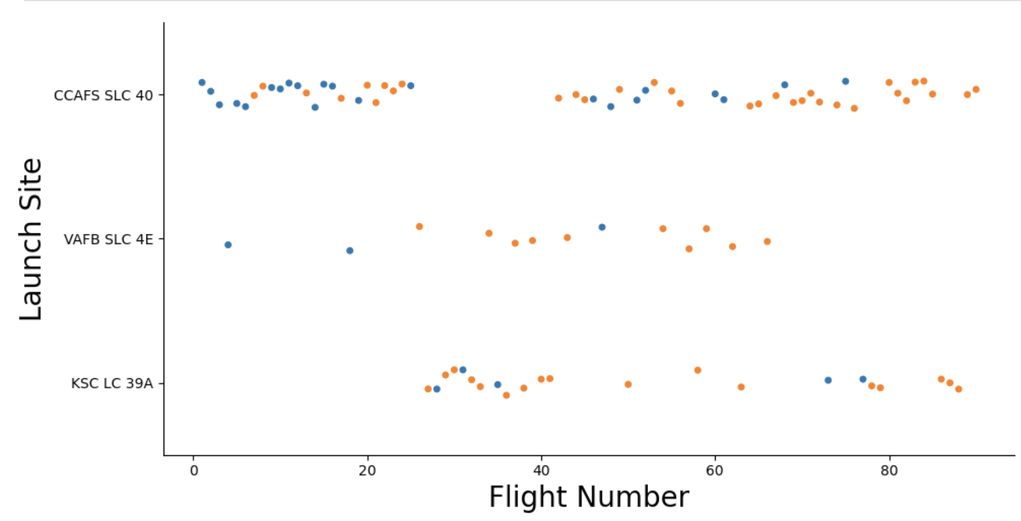
EDA with Visualization

Slide 7
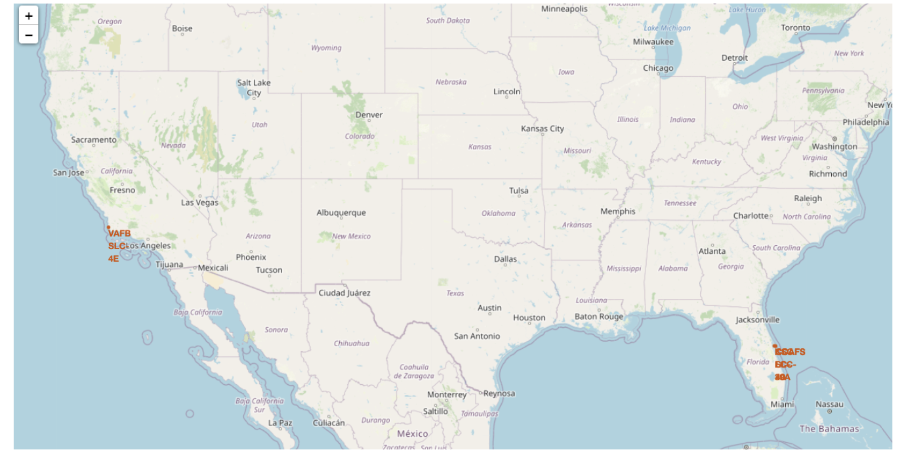
Folium Interactive Maps

Slide 8
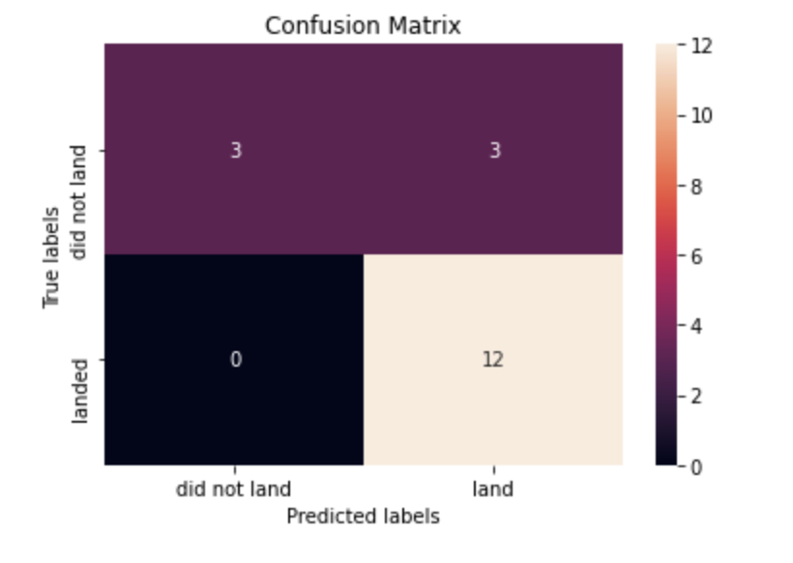
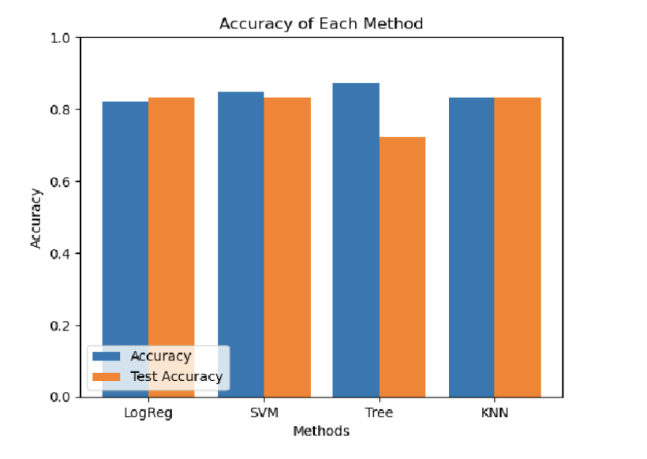
Machine Learning
Created training and testing models that created a training set that the data could be predicted from in the testing set
Tree was the most accurate for training and least for testing

Slide 9
The End

